Slide 1
Intensification and Intra-Household Decisions:
Fertilizer Adoption on Collective and Individual Fields in Burkina Faso
Melinda Smale
Food security group, department of agricultural, food, and resource economics, Michigan State University
Agricultural and Applied Economics Association annual meeting
Boston, August 2, 2015

Slide 2
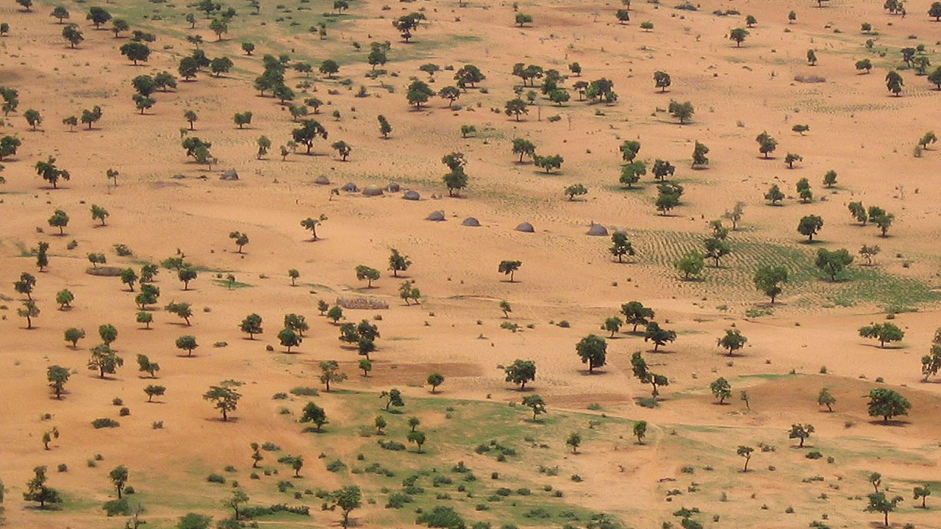

Motivation
Dryland cereal production in the Sudano-Sahelian region is high risk.
Household farm production is organized collectively under the leadership of a senior head who also allocates plots to members (sons, brothers, wives, and daughters-in-law) for individual use.
Low use rates for mineral fertilizer…on degraded, aged soils.
Notes:
Rural households in much of Sudano-Sahelian region of West Africa often have a complex organization that spans multiple generations and encompasses several nuclear households. Farming activities of the family are organized collectively under the leadership of the senior head or designate. Family members grow multiple crops on numerous plots. Historically, this social organization may reflect the fact that in dryland farming areas with harsh growing conditions, limited use of equipment and purchased inputs, success in averting hunger has depended on how effectively labor and land resources are pooled and dispatched. Risk and uncertainty have been invoked to explain various forms of collective farming. Allocation of land, labor and other inputs to individuals is the outcome of a negotiation process.

Slide 3

Previous work
Theoretical models of cooperative and non-cooperative bargaining to explain complex decision-making
Udry’s (1996) model of public-private goods:
  productivity higher on men’s plots than on women’s
  higher use rate for organic fertilizer on men’s plots
  Pareto-inefficient production
Kazianga and Wahhaj (2013) same data, similar approach:
  higher productivity on collective plots explained gender differences
Notes:
There is thread of theoretical literature that challenged the unitary model of the household, proposing alternative bargaining models, cooperative and non-cooperative, some based on game theory. In the Sudano-Sahelian region of study, some key applied literature on this topic began with Udry’s 1996 article….based on a detailed panel data set of ICRISAT’s. The analysis of gender is “confounded”
with the analysis of private vs. public goods….or individually-managed vs. collectively-managed fields.

Slide 4
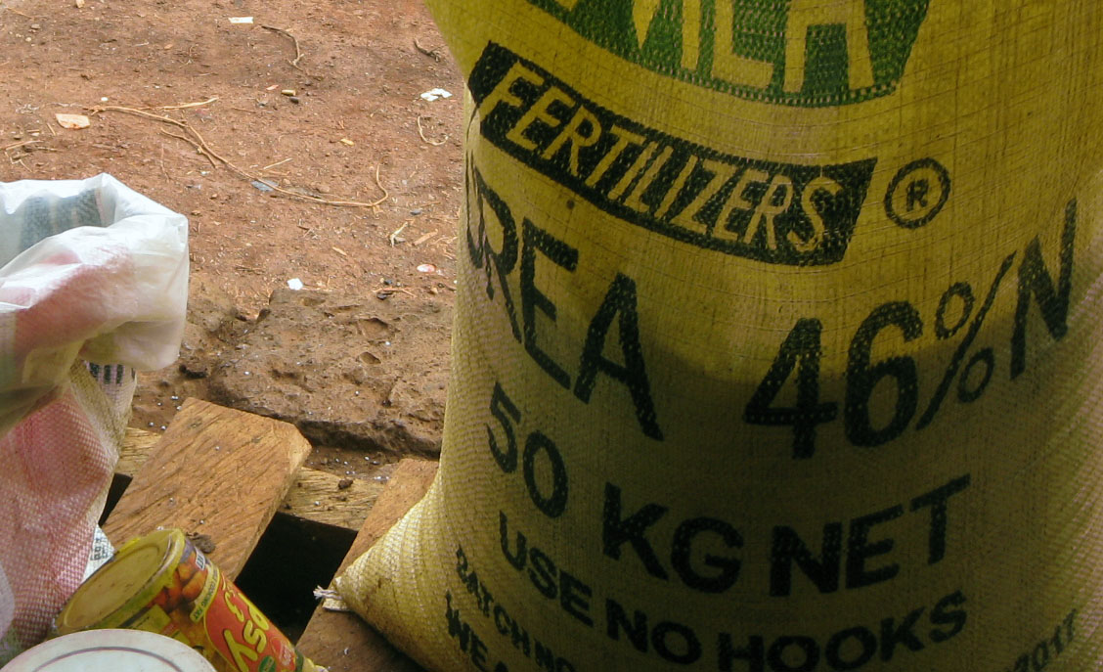
Objective
Focus on fertilizer use:
Test linkages between use on collective and individual plots
Draw inferences concerning use efficiency
Notes:
Most of this work focused on yield differentials and testing the hypothesis of Pareto-efficient production decisions.
In this paper,
--we focus instead on fertilizer use
--we also ask a modest question in this paper: rather than compare between collective and individual plots, we test the linkage between use on the two management types
-- we can derive inferences concerning efficiency of use by invoking assumptions about the production technology

Slide 5
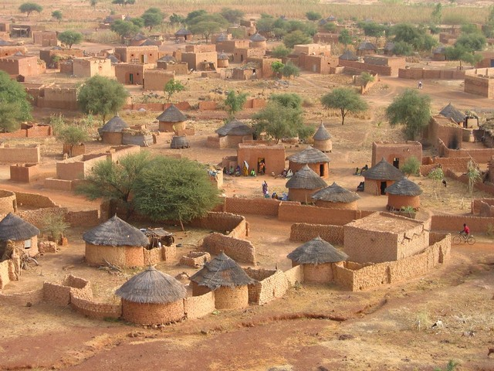
Data
Continuous Farm Household Survey (Enquête Permanente Agricole )
  Nationally representative (45 provinces, 826 villages)
  2009/10-2011/12
  2700 households growing cereals, 11 000 individual cereal plots
  513 households with paired collective and individual plots
NOAA’s Climate Prediction Center
  Rainfall variability at the commune level
Notes:
The data for this analysis are drawn from the Continuous Farm Household Survey collected by the Ministry of Agriculture and Food Security in Burkina.
The survey includes information on production, area and yield for rainfed crops as well as general information about livestock holdings, income and expenditures of rural households, and farm input use, using a nationally representative sample of rural households in 826 villages across all 45 provinces.
The data used covered the 3-year period from 2009/10 to 2011/12. During that period, over 2700 HH were continuously surveyed and about 11 000 cereal plots were individually managed.
For our analysis, we use maize plots only, and select the largest collective and individual plots within each household---513 households only with 1026 plots.

Slide 6
Conceptual Model
Draws on Fafchamps (2001)
Household members endowed with land, labor and fertilizer
Members maximize utility over consumption and leisure s.t. constraints on expenditures, production technology and time, including resource transfers.
All use the same production technology
Intra-household resource transfers may be informal
Notes:
..

Slide 7
Cooperative equilibrium
Voluntary cooperation can be ensured if the individual has greater welfare under cooperation than in autarky.
Labor sharing is evident
% distribution of plots receiving labor from members
other than the plot manager, by numbers of members
Notes:
Cooperation is more likely; also, though we have not data on transfers, we observe in our data that labor is traded within the household. About 80 percent of plots across years receive labor input from one or more household members apart for the plot manager him/herself, suggesting that input sharing is frequent. Another reason for labor sharing is that some members have comparative advantage in certain tasks; men may be more efficient in clearing land since it requires more physical strength while women and children may be more effective at weeding and harvesting.

Slide 8
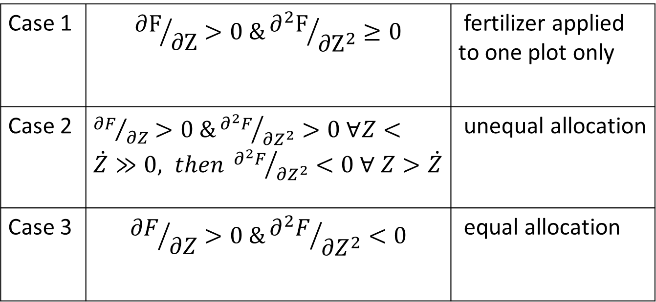
Cooperative equilibrium
Fertilizer allocation depends in part on the production function
Case 1 | $${∂F}/{∂Z}>0 \&{∂^{2}F}/{∂Z^{2}}≥0$$ | fertilizer applied to one plot only
Case 2 | ${∂F}/{∂Z}>0 \&{∂^{2}F}/{∂Z^{2}}>0$ $∀Z<\dot{Z}≫0, then {∂^{2}F}/{∂Z^{2}}<0 ∀ Z>\dot{Z}$ | unequal allocation
Case 3 | $${∂F}/{∂Z}>0 \&{∂^{2}F}/{∂Z^{2}}<0$$ | equal allocation
Notes:
In the cooperative equilibrium, the resource allocation
(amount of fertilizer available for use) across plots depends
in part on the properties of the production function.
Case 1: Hence the optimal level of fertilizer equals the total fertilizer available at the household for one plot and zero for others, ceteris paribus. This is because it is optimal to allocate an infinite amount of fertilizer on a single plot. Will all of the fertilizer be applied to collective plots managed by the household head or individual plots managed by other members of the household? The answer is likely to depend on the bargaining power (i.e., function of elasticity of demand and supply of resources, social norms) between the household head and other members. Also, if the initial allocation is that the household head has a positive fertilizer endowment while others have no fertilizer, we may expect the household head to have more bargaining power. If case 1 holds true, then we will expect most of the fertilizer to be applied to a collective plot managed by the household head. However, it is unrealistic to expect case 1 to occur since production functions are never globally convex.
Case 2: It may be more reasonable to expect that the production function is first increasing at an increasing rate, and then increasing at a decreasing rate in fertilizer (${∂F}/{∂Z}>0 \&{∂^{2}F}/{∂Z^{2}}>0$ $∀Z<\dot{Z}≫0, then {∂^{2}F}/{∂Z^{2}}<0 ∀ Z>\dot{Z})$. In this case, we may expect to see a large proportion of fertilizer applied to a single plot and perhaps no fertilizer applied to some plots.
Case 3: Due to decreasing returns to scale of fertilizer, it is optimal to allocate fertilizer equally across plots. is the usual case assumed in the applied literature. For example, tests of Pareto efficiency invoked by Udry (1996) and Kazianga and Wahhaj (2013) are derived based on the same assumptions about the curvature of the production function. Koussoube and Nauges found this type of relationship in the same data source we use.

Slide 9
Reduced form
Fertilizer_individual =
f(crop, fertilizer_collective, characteristics of plot manager, plot, household, market, weather)
Assuming linear functional form, coefficient on fertilizer_collective:
Case 1: β = 0
Case 2: 0 < β < 1
Case 3: β = 1
Notes:
An equal distribution of fertilizer across plots implies for every one kg increase in amount of fertilizer used on the collective plot, there is a one unit increase in the fertilizer used on individually managed plots.
Other variables also determine the allocation of fertilizer. Plot characteristics matter since plots with a higher fertilizer response should be allocated more fertilizer. The crop matters because some crops have a larger marginal revenue product of fertilizer than others. Maize, for example, accounts for a large share of the fertilizer applied to crops in Sub-Saharan Africa and exhibits a higher response rate than other cereal crops such as sorghum or millet (Yanggen et al. 1998). The preferences of household members also enter the equation, since they determine the shadow prices of fertilizer, labor/leisure and land. These are captured by plot manager characteristics. Shadow prices are influenced in part by transactions costs associated with market infrastructural development. We also expect more experienced and efficient producers may be allocated more fertilizer. We may also expect specialization in specific crops if experience increases from ‘learning by doing’. This would result in household members growing a specific type of crop over time and not others. But this factor is controlled by crop and plot manager. Finally, weather characteristics also determine the amount of fertilizer applied.

Slide 10
Econometrics
Bivariate probit: use (0,1) | Tobit: intensity of use (N kg/ha | Cragg: double hurdle (0,1) ; N kg/ha > 0
Seemingly unrelated | Test endogeneity with Control Function Approach | Test if determinants differ between decisions
Recursive | Instruments collective plot characteristics | Bootstrap APEs
Mundlak-Chamberlin | Mundlak-Chamberlin | Mundlak-Chamberlin
Notes:
--The seemingly-unrelated, bivariate probit specification addresses potential simultaneity by taking into account the correlation between the residuals of the two equations in the system. --stochastic linkage
--The recursive formulation introduces the potential for a causality in one direction. The statistical test on the coefficient of the regressor (Z), which indicates fertilizer use on collectively-managed fields, would provide evidence of a systematic relationship.
--the Tobit-Tobit (two stage model, with collective plot characteristics as determinants of collective fertilizer use, and collective fertilizer use entered as a determinant of individual fertilizuer use…allows us to test endogeneity.
--In all cases, we use the Mundlak Chamberlain device to control for time-invariant, unobserved household heterogeneity.

Slide 11
Descriptive Statistics
Probability of use**
Collective | 46%
Individual | 39%
Unconditional mean (N kg/ha)
Collective | 20 kg/ha
Individual | 25 kg/ha
Conditional mean (N kg/ha) ***
Collective | 43 kg/ha
Individual | 65 kg/ha
Notes:
The Kolmogorov-Smirnov test supports differences in underlying distributions with a p-value of 0.007. The distribution of positive values on individual plots lies slightly to the right of those corresponding to collective fields, with a mode at higher values.

Slide 12
Econometric Results: Bivariate probit
1. Statistical tests support independent, recursive models
Adoption of fertilizer on collective plot raises adoption on individual plots by 0.32
Adoption of fertilizer on individual plots does not affect adoption on collective plots
2. Other significant factors
Collective plots: plot manager married, younger; family member education; plot characteristics, extension contact, credit access
Individual plots: plot characteristics, number of agro-dealers in province
Notes:
The seemingly-unrelated bivariate probit regressions for individually- and collectively-managed plots are shown in Table 3, columns 1 and 2. With respect to our major hypotheses, we fail to reject the null hypothesis that the two equations are uncorrelated with a Wald test (p-value=0.840)). Thus, we estimate the final recursive models as two independent probit models. Marginal effects for collective and individual plots are shown in columns 3 and 4. We find a positive, statistically significant coefficient that systematically relates the likelihood of fertilizer use on collectively-managed to fertilize use on individually-managed plots. The effect is large: adoption of fertilizer on a collective plot contributes to an average of a 0.32 rise in adoption probability on an individual plot. However, the converse does not hold true: fertilizer use on individual plots does not determine use on collective plots (we fail to reject the null hypothesis on the coefficient). Not reported here for brevity, these results are available from the authors.

Slide 13

Econometric Results: Tobit
  Fertilizer use on collective fields can be treated as exogenous in the fertilizer use model for individual fields
  The marginal effect of fertilizer applied to collective fields on use rates applied to individual fields is 0.19 N nutrient kgs/ha
  Fertilizer use unequal
Notes:
The residual from the first stage regression is statistically insignificant, leading us to conclude that we may again treat fertilizer use intensity on collective fields as an exogenous regressor in the fertilizer use model for individual fields.
The marginal effect of fertilizer applied to collective fields on use rates applied to individual fields is 0.19 nitrogen nutrient kgs/ha.

Slide 14
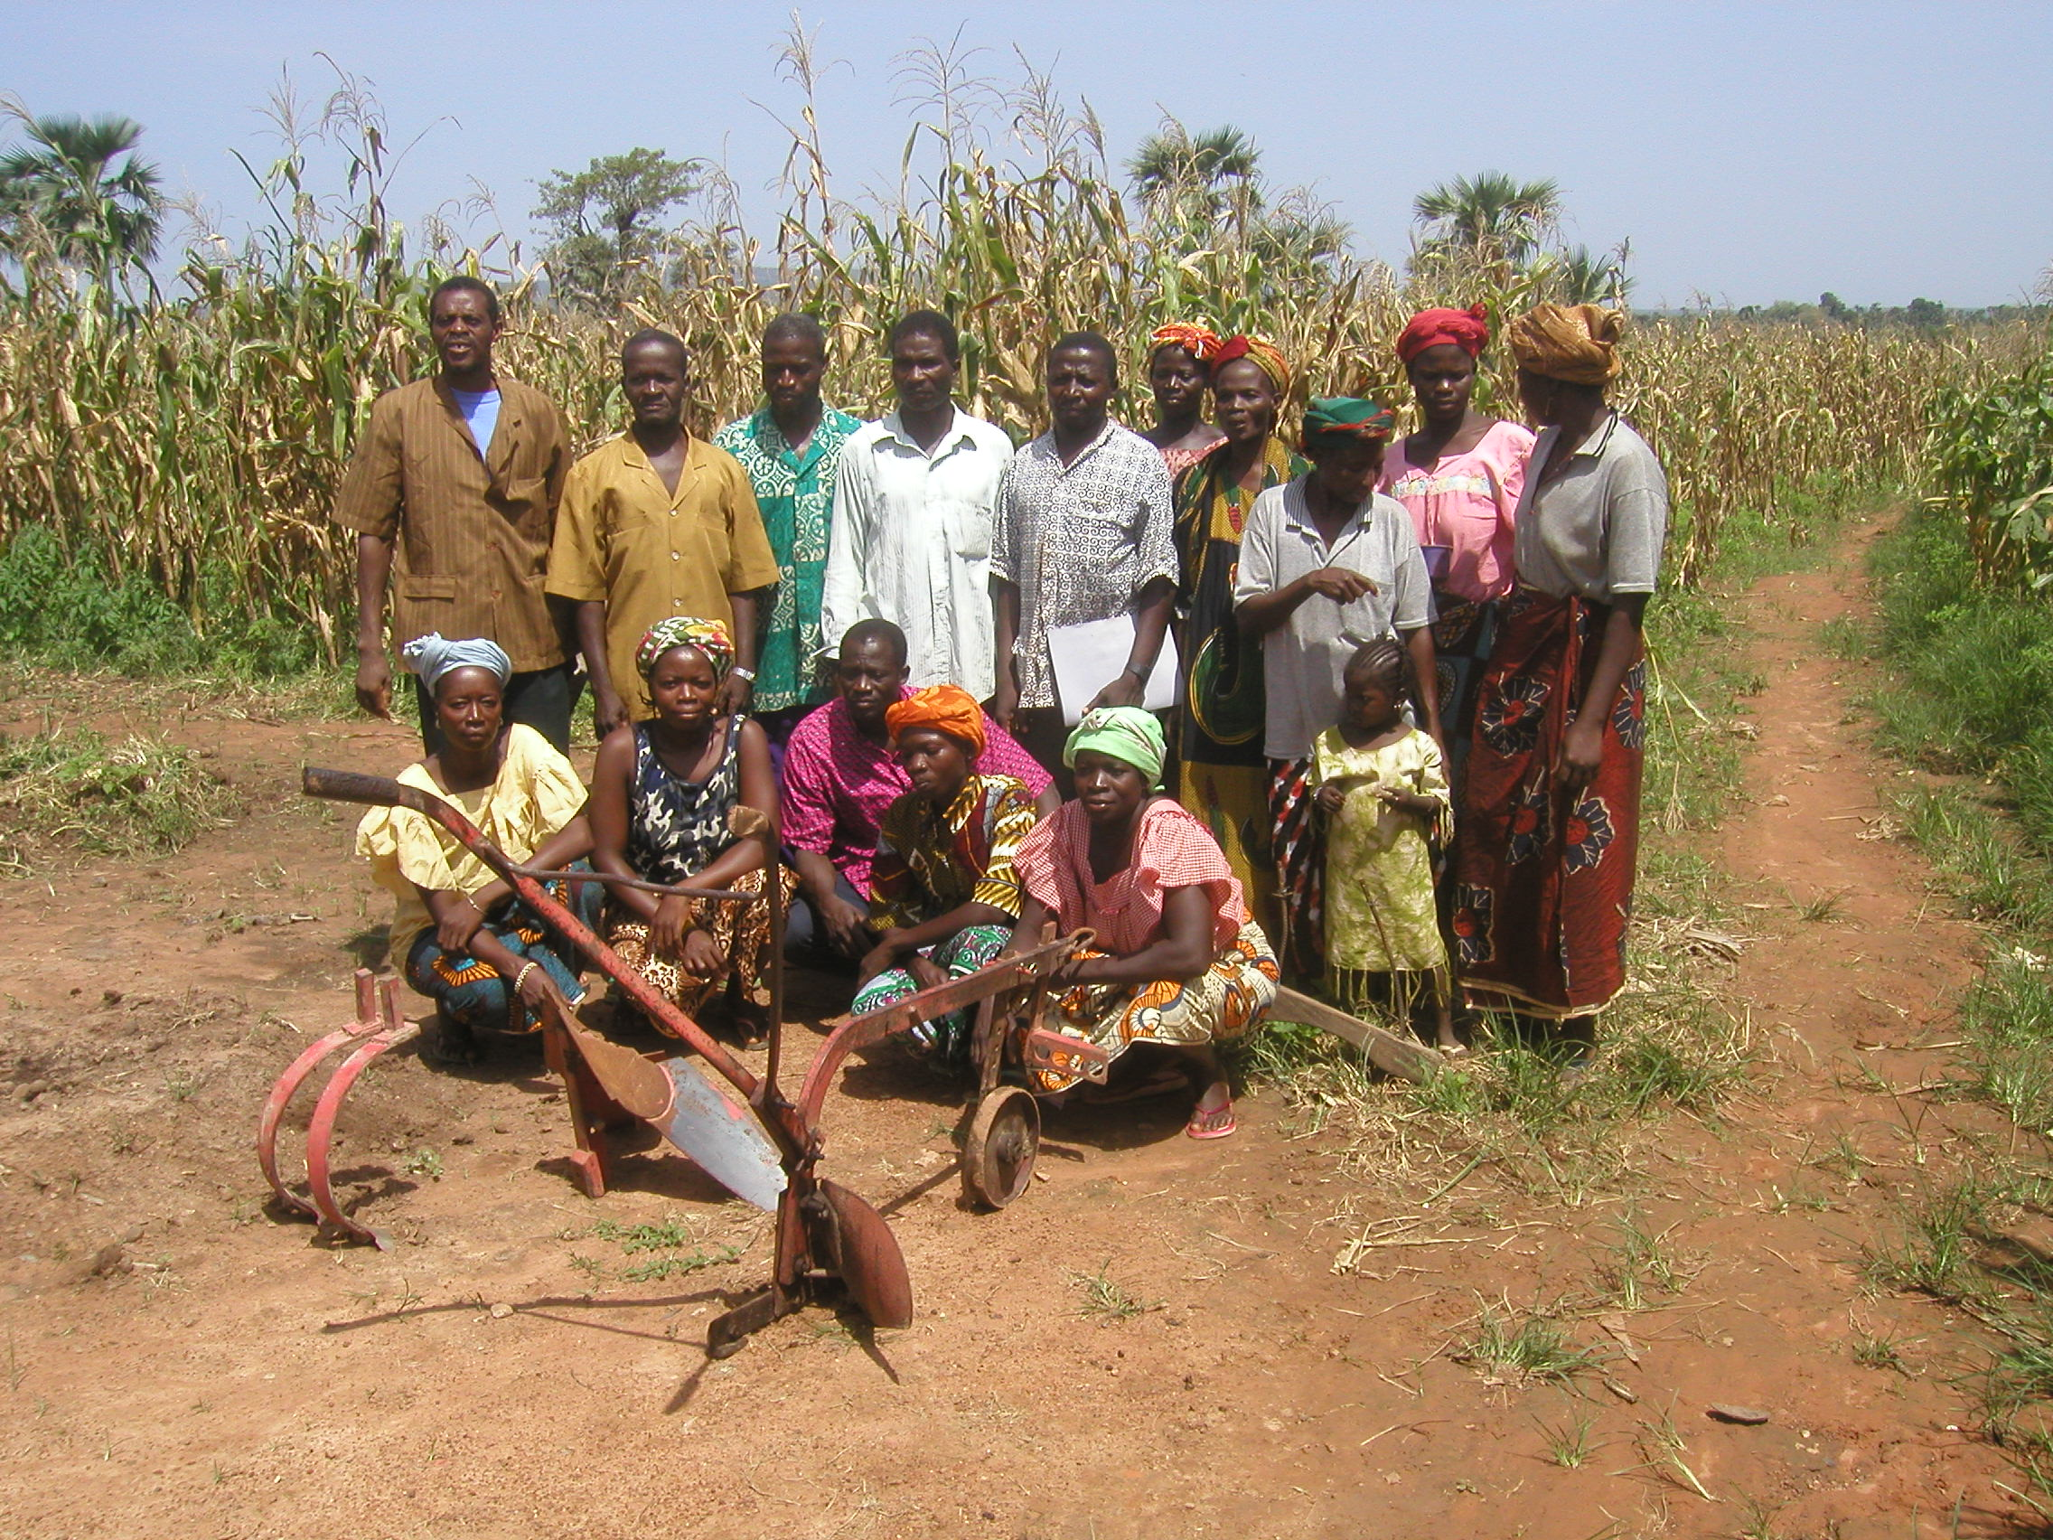
Econometric Results: Cragg
  fertilizer use on collective fields exogenous in individual model
  positive effect of fertilizer use in collective fields on decision to use and intensity of use in individual fields
  determinants differ between use and intensity-of-use decisions:
    Distance to plot, plot size lower intensity but increases likelihood of use
    Rainfall important in intensity of use
    Extension contact important in likelihood of use

Slide 15
Conclusions
Fertilizer use on collective plots recursively and positively affects the likelihood of use and intensity of use on individual plots
Coefficient values suggest that fertilizer is not equally distributed across plots, ceteris paribus
Notes:
Regarding the last finding: Assuming that case 3 of the conceptual model holds true (global concavity in the response function), and that the assumption of a common production technology holds true, our findings would be consistent with the hypothesis of inefficient outcomes in household bargaining because the value of the coefficient is far from 1. The household may simply fail to allocate inputs, here fertilizer, effectively across plots, as previously suggested by Udry (1996), Akresh (2011) and Kazianga and Wahaj (2013). Some frictions may exist within the household that hinders members from producing efficiently as a unit. Or, case 3 does not hold true and an alternative explanation can be derived from the conceptual framework about why it may be efficient to unequally distributed fertilizer across plots. If the curvature of the production function does not simply follow a global concavity, then there may be increasing returns to scale for fertilizer at very low levels, especially for soils that are extremely depleted in nutrients.

Slide 16
Policy Implications
“Trickle down” within households, and the strong effect of credit and extension on fertilizer use in collective fields, supports targeting heads as cost-effective
Unequal distribution of fertilizer across plots indicates that other strategies might better serve goals such as reducing migration of young men and women.
Notes:
Better access to credit and extension services positively influence fertilizer adoption on collective plots. This reflects that the head is the official point of contact of extension agents and development programs. The finding suggests that an increase in total household fertilizer will “trickle down” to individuals within the households, and may explain why so many agricultural development programs and policies target household heads. Doing so is more cost-effective. However, inputs may not be equally distributed among household members and, thereby, among plots. If cost-effectiveness is not the most desired outcome, then targeting individual household members may be more appropriate. For instance, if reducing youth rural-urban migration through increasing agricultural productivity (and income) is the objective, then programs and policies to improved fertilizer access and use should target young, male and female managers of individual plots. The design and implementation of effective agricultural programs and policy depends on a better understanding of the decision-making within households.

